Slide 1


Introduction to
Robotic Process Automation
Title of the Project
Your Register No:220701038
Name:Barathraj V L
Guide Name:Jinu Sophia J
Designation and Department: B.E Computer Science and Engineering

Slide 2
Abstract:Sales Report Generation Bot
In many organizations, the process of generating sales reports is a manual and time-consuming task. Sales data, typically stored in Excel, must be converted into formatted Word documents, and then into PDFs for distribution and presentation. This process not only takes a significant amount of time but is also prone to human errors and inconsistencies, which can affect the quality and accuracy of reports.
To address these challenges, the Sales Report Generation Bot was developed using UiPath, a leading Robotic Process Automation (RPA) platform. The bot automates the entire process of extracting sales data from Excel, populating a predefined Word template with the data, and then converting the Word document into a PDF.
Key features of the bot include:
Data Extraction: Automatically reads and extracts sales data from specified Excel files.
Report Generation: Fills a Word template with the extracted data, ensuring consistent formatting and presentation.
Conversion to PDF: Converts the Word document to a PDF file for easy sharing and printing.
File Management: Saves the generated PDF in a designated folder, automatically naming and storing the report.
By automating these repetitive tasks, the bot delivers several benefits:
Time Savings: The bot significantly reduces the time spent on report generation.
Increased Accuracy: Automation eliminates human errors that can occur during manual data entry and formatting.
Consistency: The bot ensures that each report is consistently formatted and follows the same structure, improving professionalism and standardization.
Scalability: The bot can easily be adapted to handle larger datasets or additional report formats, making it a scalable solution for future needs.
This project showcases the power of RPA in transforming manual processes into efficient, error-free workflows, helping organizations save time, reduce costs, and improve the quality of their business reports.

Slide 3
Need for the Proposed System
Time-Consuming Manual Processes:
In many organizations, generating sales reports from Excel requires several steps: extracting data, manually inputting it into a Word document, formatting it correctly, and finally converting it into a PDF. This process is highly time-consuming and repetitive.
Human Error and Inconsistencies:
Manual data entry and report formatting leave room for human errors, such as incorrect data placement, typos, or inconsistent formatting. These errors can compromise the accuracy and professionalism of the reports.
Lack of Standardization:
The process of manually formatting reports may vary depending on who is creating the report, leading to a lack of standardization in the final output.
Resource Intensive:
Since generating reports requires human involvement at multiple stages, it consumes significant resources, including the time of skilled employees, who could be better utilized for higher-value tasks.
Demand for Faster, More Reliable Report Generation:
As businesses grow, the volume of sales data also increases. Manual methods struggle to keep up with the demand for quick, consistent, and reliable report generation.

Slide 4
Advantages of the Proposed System
1. Time Efficiency
Automated Process: The system eliminates the need for manual intervention in generating reports, significantly reducing the time required to process large datasets.
2. Accuracy and Consistency
Error Reduction: By automating repetitive tasks, the system reduces the chance of human errors that often occur in manual data entry, formatting, and conversion.
3. Cost Savings
Resource Optimization: Automating manual tasks frees up valuable human resources, allowing employees to focus on higher-value tasks rather than repetitive report generation.
4. Reduced Human Effort
No Need for Manual Conversions: The bot performs the task of converting Excel data into Word and then converting Word to PDF, eliminating the need for manual handling of multiple applications.
5. Enhanced Security
Secure Document Generation: The reports are automatically stored in secure folders, and access can be controlled based on user permissions, reducing the risk of unauthorized access to sensitive sales data.
6. Support for Decision-Making
Real-time Reporting: The bot can be scheduled to run at specific intervals, ensuring that reports are always up to date and ready for business decision-makers.

Slide 5
Literature Survey
1. Introduction to Robotic Process Automation (RPA)
This section would explain the concept of RPA (Robotic Process Automation). RPA refers to the use of software robots to automate repetitive and rule-based tasks, like filling out forms or generating reports, which would otherwise be done manually by humans. This makes work more efficient and accurate. You would cite existing research or definitions from industry experts to show that RPA is an established practice.
2. UiPath as an RPA Tool
Here, you introduce UiPath, the specific RPA tool you're using for your project. You would explain how UiPath is a widely-used automation tool and mention its features, such as the ability to work with Excel, Word, and PDF files. This part connects the theory of RPA to the tool you're using to implement your solution.
3. Automation in Report Generation
In this section, you would look at how automation is already being used in other industries to generate reports. Many companies automate tasks like generating sales or performance reports, which involves extracting data from Excel or other sources, formatting it, and generating documents (like Word or PDF files). This gives a real-world application for your project and justifies why automating report generation is important.
4. Excel to Word and Word to PDF Automation
You would explore how data transfer between formats (e.g., from Excel to Word or Word to PDF) is typically automated. This is directly related to your project, as your UiPath bot is performing similar tasks. This section helps you understand common challenges or approaches others have used, so you can improve your implementation.
5. Benefits and Challenges of RPA in Report Generation
Here, you review the pros and cons of automating report generation. Benefits include time savings, accuracy, and consistency. Challenges could involve issues like setting up templates or handling complex data structures. Understanding these helps you anticipate potential issues and refine your approach.
6. Future Directions in Report Automation
Finally, this section looks at the future potential of RPA in report generation. It discusses new trends like combining RPA with AI to make reports smarter or more interactive. This gives context to how your work fits into a broader trend and might inspire future improvements.

Slide 6
Main Objective
To design and implement an RPA-based solution using UiPath that automates the process of generating sales reports by converting data from Excel spreadsheets into Word documents and then converting those documents into PDFs, with the aim of improving efficiency, reducing errors, and ensuring consistency in report generation.
The main objective is to leverage UiPath RPA to automate the end-to-end process of sales report generation, from extracting data in Excel to generating formatted Word documents and converting them into PDFs, with the ultimate goals of:
Saving time and resources,
Ensuring accuracy and consistency,
Reducing human error,
Streamlining reporting workflows.
This project aims to create a solution that is not only efficient but also scalable and adaptable to various business needs.

Slide 7
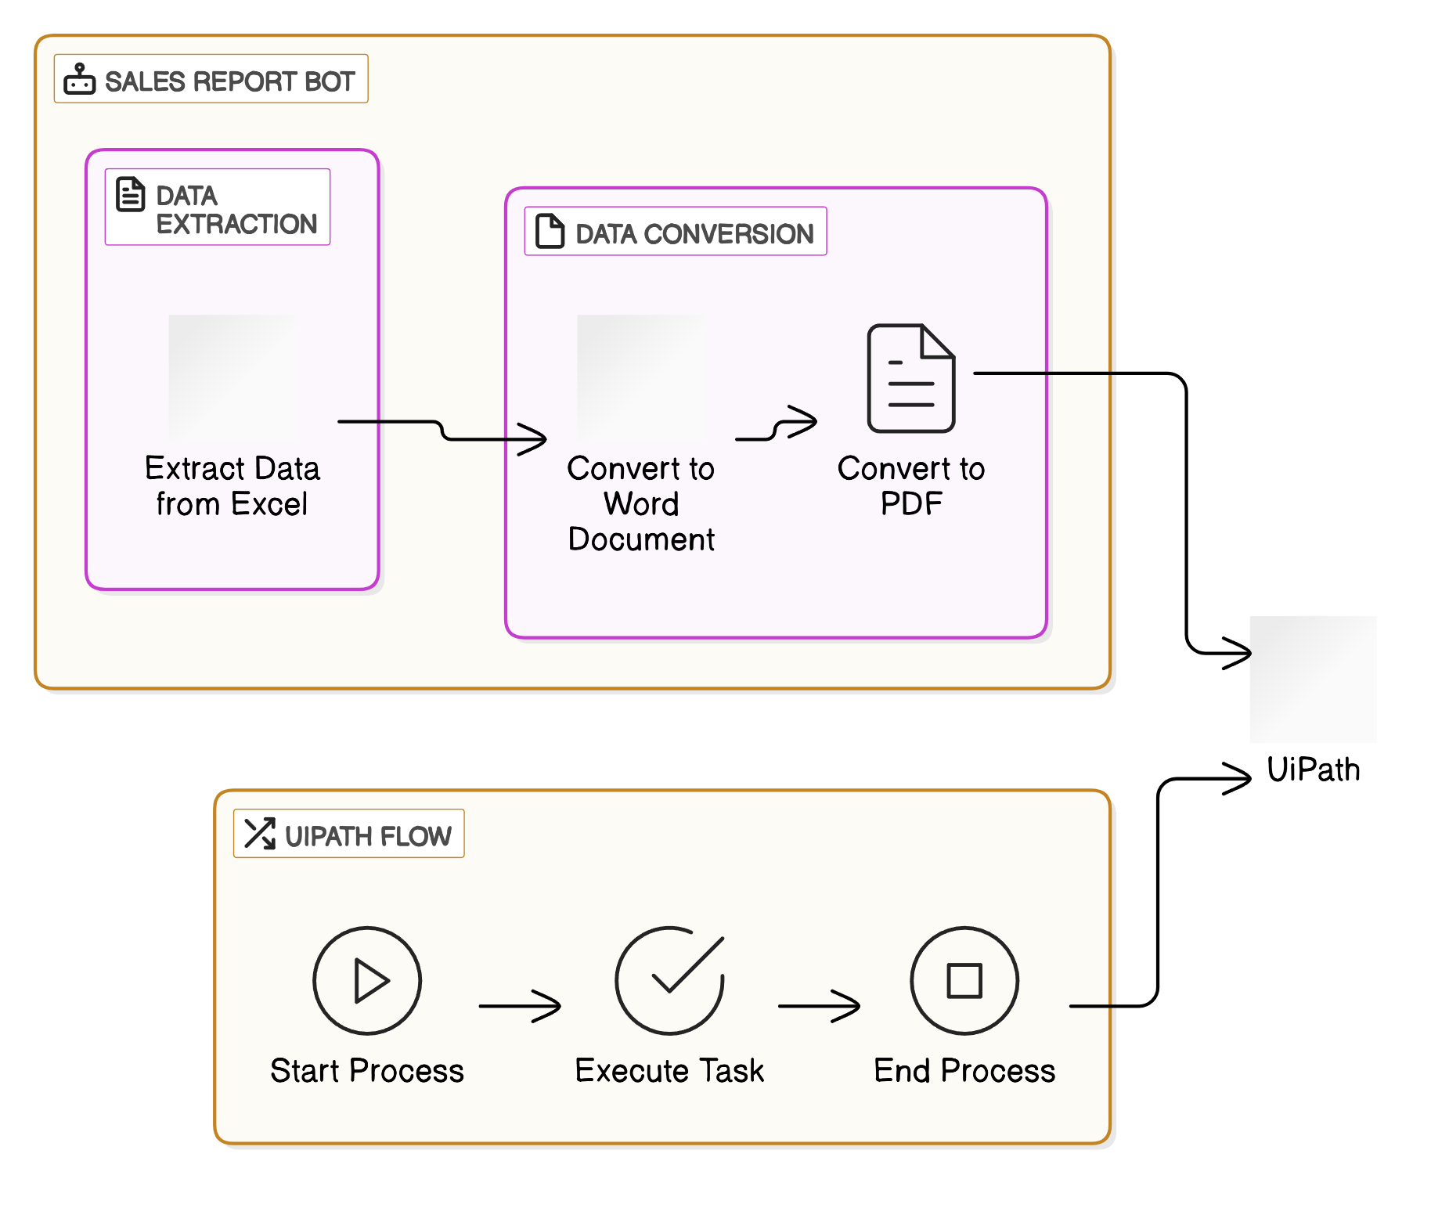
Architecture

Slide 8
System Requirements
Hardware Requirements:
Processor: Intel Core i3 (or equivalent), 1.5 GHz or higher
Memory (RAM): 4 GB (8 GB recommended for better performance)
Storage: 5 GB free disk space (SSD recommended)
Display: 1024x768 resolution or higher
Software Requirements:
Operating System: Windows 10 (64-bit) or Windows Server 2016/2019
UiPath Studio: Latest version (Community or Enterprise)
UiPath Robot: For automation execution
Microsoft Excel & Word: For reading data and generating reports
Adobe Acrobat Reader (or any PDF reader) for viewing PDF reports
Network & Security:
Internet Connection: Required for cloud integrations and updates
Permissions: Sufficient permissions for file access and automation execution
Firewall/Antivirus: Allow UiPath Studio and Robot to run without interference

Slide 9
Functional Description
each of these modules is designed to perform a specific function in the Sales Report Generation Bot. Below is a simplified workflow that you can include in your PowerPoint for easy reference:
Module 1: Data Extraction & Processing from Excel
Input: Sales data from Excel.
Process: Data extraction, cleaning, and structuring.
Output: Processed data ready for report generation.
Module 2: Report Generation in Word
Input: Processed data from Excel.
Process: Word document creation, data insertion, formatting.
Output: Formatted Word report.
Module 3: Conversion to PDF
Input: Word document.
Process: Convert to PDF format.
Output: PDF report.
Module 4: Report Storage & Output
Input: PDF report.
Process: Save or email the report.
Output: PDF file saved in the specified location or sent by email.

Slide 10
Functional Description
DFD for Module 1 (Data Extraction & Processing):
External Entity: Excel File
Process: Data extraction and transformation
Data Store: Structured sales data
Output: Cleaned data ready for report generation
Activity Diagram for Module 2 (Report Generation in Word):
Activities: Read data -> Create Word doc -> Insert data into report -> Apply formatting -> Save Word doc
DFD for Module 3 (PDF Conversion):
External Entity: Word Document
Process: Convert Word to PDF
Output: PDF report saved or forwarded.
Activity Diagram for Module 4 (Storage and Output):
Activities: Save to storage -> Send email (optional)

Slide 11
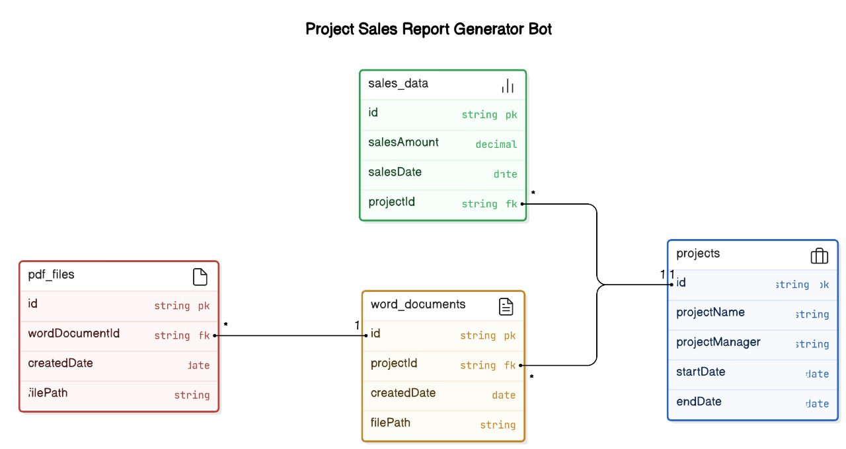
Table Design
Simplified ERD (Entity-Relationship Diagram)
Since your project only involves converting Excel data into Word and PDF, the system can be simplified to focus on the SalesData and Reports tables.
SalesData stores the raw sales data (from Excel).
Reports stores the generated report (Word and PDF).

Slide 12
Process Design
Main Process: Sales Report Generation
Read Excel Data: Extract sales data from Excel.
Process Data: Clean and format the data.
Generate Word Report: Create a formatted Word document with the data.
Convert Word to PDF: Convert the Word report to PDF.
Save Reports: Save both Word and PDF reports.
Sub Processes:
Data Extraction & Processing
Read and clean data from Excel.
Word Report Generation
Create and format the Word document.
Word to PDF Conversion
Convert Word document into PDF.
Save Reports
Save the Word and PDF files to the specified location.
Process Flow:
Start → 2. Data Extraction → 3. Word Report Generation → 4. Convert to PDF → 5. Save Reports → End

Slide 13
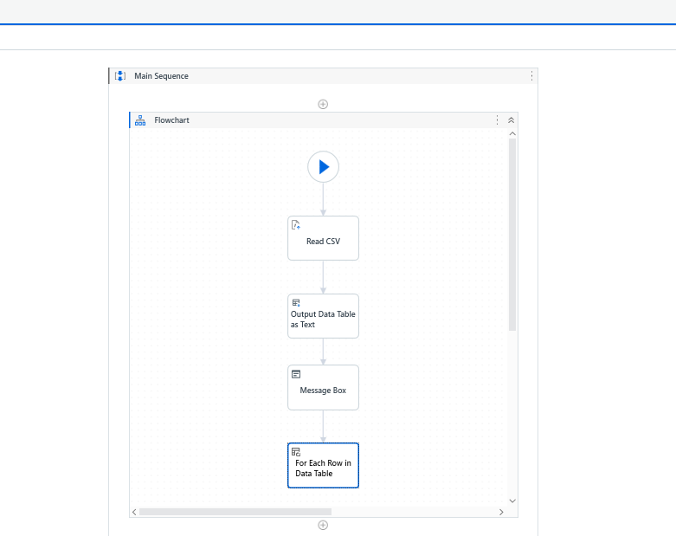
Implementation
Implementation of Module 1: Data Extraction and Processing
Description:
Extract sales data from Excel.
Clean and format the data (e.g., remove errors, adjust date formats).
Store data for report generation.
Screenshot:

Slide 14
Testing
Testing Steps:
Unit Testing:
Test each module (Data Extraction, Word Report Generation, PDF Conversion) independently.
Verify data extraction from Excel is accurate.
Integration Testing:
Test the complete flow from data extraction to Word/PDF generation.
Ensure that data is properly transferred from Excel to Word and then to PDF.
End-to-End Testing:
Test the entire system with real-world sales data.
Ensure the output is correct (formatted Word report and PDF) and saved in the correct location.
Tools Used:
UiPath for automation.
Excel for input data.
Microsoft Word for report generation.
PDF for final report format.
Test Cases:
Test with different sets of sales data (varied product types, sales amounts, etc.).
Check if the generated Word and PDF files are formatted correctly.

Slide 15
Conclusions
Successful Automation: The Sales Report Generation Bot effectively automates the process of converting Excel data into well-formatted Word and PDF reports.
Efficiency Improvement: The automation saves significant time by eliminating manual report generation.
Accuracy: The bot ensures accurate data extraction, report formatting, and file conversion.
Scalability: The system can handle large volumes of sales data and generate reports for multiple salespersons.
Future Enhancements: Possibility to add features like email notifications, dynamic report generation based on filters, or integration with other systems.

Slide 16
Future Enhancement
Email Notifications: Add functionality to automatically email the generated reports to relevant stakeholders (e.g., sales managers, team members).
Dynamic Report Filters: Allow users to filter data (e.g., by region, date range, salesperson) for more customized report generation.
Data Integration: Integrate with other systems (CRM, ERP) to pull sales data directly for automated report generation.
User Interface: Develop a user-friendly interface for non-technical users to upload data and generate reports without needing to interact with UiPath.
Report Scheduling: Implement scheduled report generation at regular intervals (daily, weekly, monthly).
Cloud Storage Integration: Save reports to cloud storage (e.g., Google Drive, OneDrive) for easier access and sharing.

Slide 17
Thank You

